Slide 1
ER MODEL
An Entity–relationship model (ER model) describes the structure of a database with the help of a diagram, which is known as Entity Relationship Diagram (ER Diagram).
An ER model is a design or blueprint of a database that can later be implemented as a database.
The main components of E-R model are: entity set and relationship set.

Slide 2
ER DIAGRAM
An ER diagram shows the relationship among entity sets.
An entity set is a group of similar entities and these entities can have attributes.
ER diagram shows the complete logical structure of a database.

Slide 3
Why use ER Diagrams?
Helps you to define terms related to entity relationship modelling.
Provide a preview of how all your tables should connect, what fields are going to be on each table.
Helps to describe entities, attributes, relationships.
ER diagrams are translatable into relational tables which allows you to build databases quickly.
ER diagrams can be used by database designers as a blueprint for implementing data in specific software applications.
The database designer gains a better understanding of the information to be contained in the database with the help of ER diagram.

Slide 4
ER DIAGRAM
Rectangle: Represents Entity sets.
Ellipses: Attributes
Diamonds: Relationship Set
Lines: They link attributes to Entity Sets and Entity sets to Relationship Set
Double Ellipses: Multivalued Attributes
Dashed Ellipses: Derived Attributes
Double Rectangles: Weak Entity Sets
Double Lines: Total participation of an entity in a relationship set

Slide 5
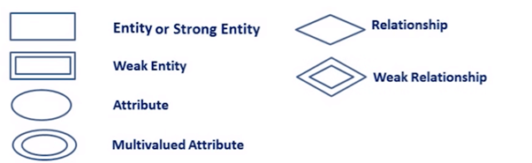

Slide 6
Components of ER DIAGRAM
ER diagram has three main components:
Entity
Attribute
Relationship

Slide 7
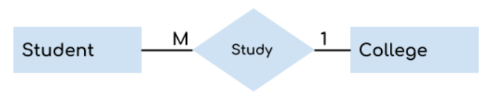
Components of ER DIAGRAM
Entity
An entity is an object or component of data.
An entity is represented as rectangle in an ER diagram.
For example: In the following ER diagram we have two entities Student and College and these two entities have many to one relationship as many students study in a single college

Slide 8
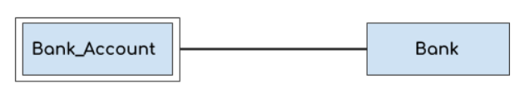
Components of ER DIAGRAM
Weak Entity:
An entity that cannot be uniquely identified by its own attributes and relies on the relationship with other entity is called weak entity.
The weak entity is represented by a double rectangle.
For example – a bank account cannot be uniquely identified without knowing the bank to which the account belongs, so bank account is a weak entity.

Slide 9
Components of ER DIAGRAM
Attribute
An attribute describes the property of an entity.
An attribute is represented as Oval in an ER diagram.
There are four types of attributes:
1. Key attribute 2. Composite attribute 3. Multivalued attribute 4. Derived attribute

Slide 10
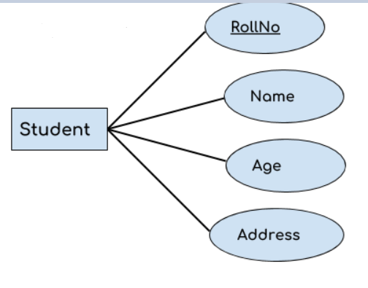
Components of ER DIAGRAM
Key attribute:
A key attribute can uniquely identify an entity from an entity set.
For example, student roll number can uniquely identify a student from a set of students.
Key attribute is represented by oval same as other attributes however the text of key attribute is underlined.

Slide 11
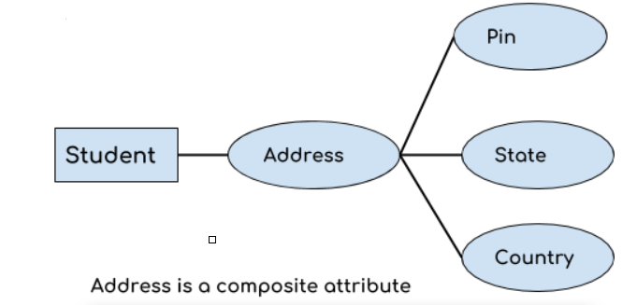
Components of ER DIAGRAM
Composite attribute
An attribute that is a combination of other attributes is known as composite attribute.
For example, In student entity, the student address is a composite attribute as an address is composed of other attributes such as pin code, state, country.

Slide 12
Components of ER DIAGRAM
Multivalued attribute:
An attribute that can hold multiple values is known as multivalued attribute. It is represented with double ovals in an ER Diagram. For example – A person can have more than one phone numbers so the phone number attribute is multivalued.
Derived attribute:
A derived attribute is one whose value is dynamic and derived from another attribute. It is represented by dashed oval in an ER Diagram. For example – Person age is a derived attribute as it changes over time and can be derived from another attribute (Date of birth).

Slide 13
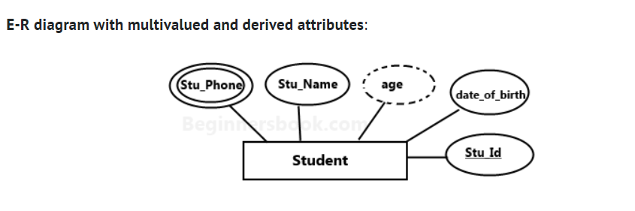
Components of ER DIAGRAM

Slide 14
Components of ER DIAGRAM
Relationship
A relationship is represented by diamond shape in ER diagram, it shows the relationship among entities.
There are four types of relationships(Degree/Cardinality): 1. One to One 2. One to Many 3. Many to One 4. Many to Many

Slide 15
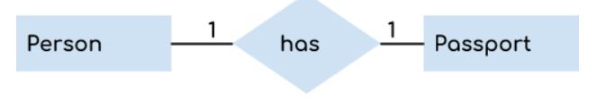
Components of ER DIAGRAM
One to One Relationship
When a single instance of an entity is associated with a single instance of another entity then it is called one to one relationship. For example, a person has only one passport and a passport is given to one person.

Slide 16
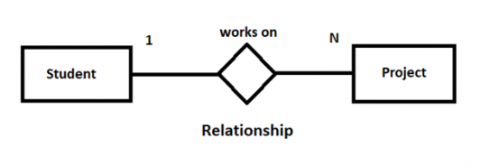
Components of ER DIAGRAM
One to Many Relationship
When a single instance of an entity is associated with more than one instances of another entity then it is called one to many relationship.
A student can work on more than one project.
An individual student working on 2 projects at a time would be considered as One-to-Many relationship

Slide 17
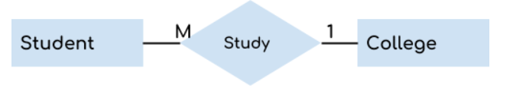
Components of ER DIAGRAM
Many to One Relationship
When more than one instances of an entity is associated with a single instance of another entity then it is called many to one relationship. For example – many students can study in a single college but a student cannot study in many colleges at the same time.

Slide 18
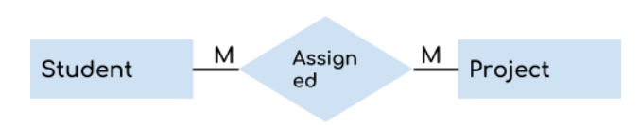
Components of ER DIAGRAM
Many to Many Relationship
When more than one instances of an entity is associated with more than one instances of another entity then it is called many to many relationship.
For example, a student can be assigned to many projects and a project can be assigned to many students.

Slide 19
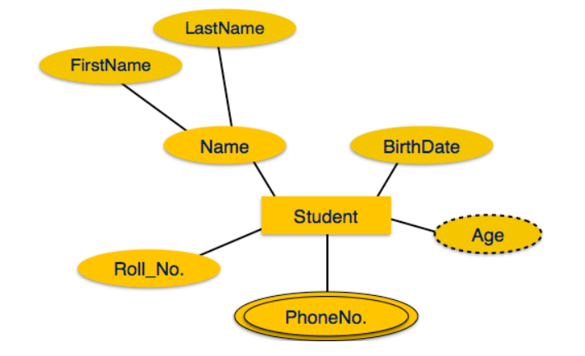
Components of ER DIAGRAM

Slide 20
Entity, Entity Type, Entity Set
Entity
An Entity may be an object with a physical existence – a particular person, car, house, or employee – or it may be an object with a conceptual existence – a company, a job, or a university course.
Entity Type
The entity type is a collection of the entity having similar attributes.
STUDENT table as an entity type because it is a collection of entities having the same attributes.

Slide 21
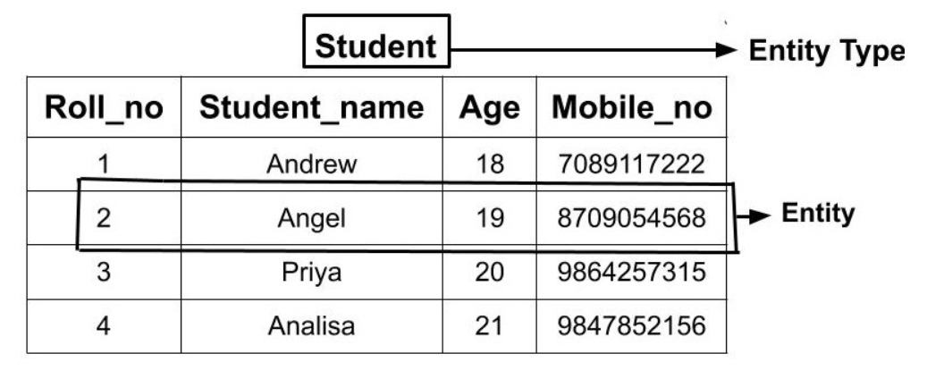
Entity, Entity Type, Entity Set

Slide 22
Entity, Entity Type, Entity Set
Entity Set
Entity Set is a collection of entities of the same entity type.
In the above example of STUDENT entity type, a collection of entities from the Student entity type would form an entity set.
We can say that entity type is a superset of the entity set as all the entities are included in the entity type.

Slide 23
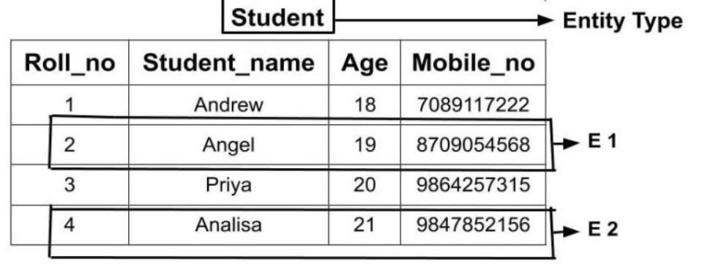
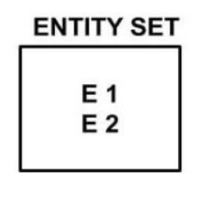
Entity, Entity Type, Entity Set

Slide 24
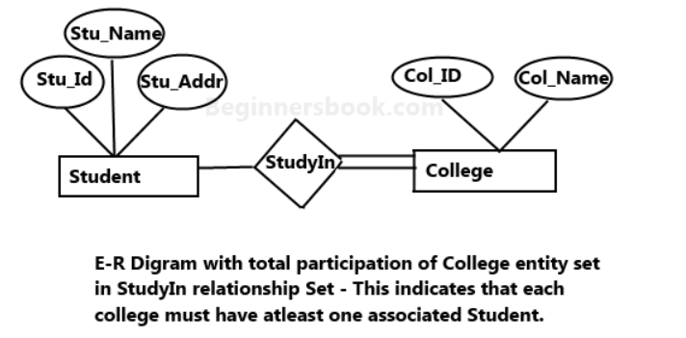
Components of ER DIAGRAM
Total Participation of an Entity set
A Total participation of an entity set represents that each entity in entity set must have at least one relationship in a relationship set. For example: In the below diagram each college must have at-least one associated Student.

Slide 25
Components of ER DIAGRAM
Weak Entity Type and Identifying Relationship:
Entity type has a key attribute which uniquely identifies each entity in the entity set.
But there exists some entity type for which key attribute can’t be defined. These are called Weak Entity type.
For example, A company may store the information of dependents (Parents, Children, Spouse) of an Employee. But the dependents don’t have existence without the employee. So Dependent will be weak entity type and Employee will be Identifying Entity type for Dependent.

Slide 26
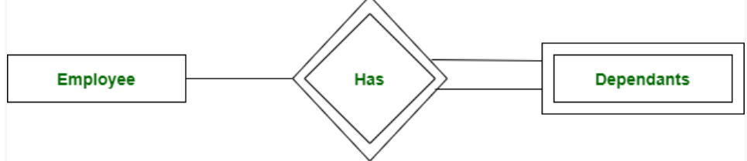
Components of ER DIAGRAM
Weak Entity Type and Identifying Relationship
A weak entity type is represented by a double rectangle.
The participation of weak entity type is always total.
The relationship between weak entity type and its identifying strong entity type is called identifying relationship and it is represented by double diamond.

Slide 27
Components of ER DIAGRAM
Types of Attributes
Single v/s Multivalued attributes
Simple v/s Composite attributes
Stored v/s Derived attributes
Key v/s Non key attribute
Complex attribute

